Slide 1
Wireshark: Protocol Analyzer

Slide 2
Protocol Analyzer
The protocol analyzer has the capability to capture and decode data packets and allows the user to inspect the packet contents.
This enables the user to investigate how information is being transferred in the network.
Additionally, the information provided by the protocol analyzer enables the user to detect, identify, and correct network problems.
The reader is next guided through the steps of installing the Wireshark protocol analyzer.

Slide 3
Installing Wireshark
To download the latest version of the software, visit www.Wireshark.org. At the Wireshark.org home page, select Download Wireshark, once completed, select your corresponding operating system.
Click Run when the dialog box appears to initiate the download process. Answer the prompts as needed and To complete setup, click Install to start the installation process. After installation you are ready to begin using the software.

Slide 4
Starting Wireshark
Step 1 Click Start—Programs—Wireshark to start the analyzer program. The procedure for starting the Wireshark Network Analyzer is the same for a MAC OS X operating in the dualboot mode with XP.
Step 2 Once Wireshark is open, click File—Open, select your CD-ROM drive, and select the Wireshark file folder. Double-click the Ch6-1.cap file to open the file.

Slide 5
Wireshark
Once you have opened the Ch10-1.cap capture in Wireshark, you should see the captured packets displayed on the detail view screen as shown.
In this example, the information on the screen is showing the transfer of packets that occurs when one computer pings another.

Slide 6
Wireshark
In this case, computer 1 pinged computer 2. The MAC and IP addresses are listed for your reference .
The MAC and Assigned IP addresses for computer 1 and computer 2
Name (Hostname) MAC Address IP Address
Computer 1 00-10-A4-13-99-2E 10.10.10.1
Computer 2 00-10-A4-13-6C-6E 10.10.10.2

Slide 7
The detail view screen (Ch10-1.cap)
The captured packets showing the ping from computer 1 to computer 2.
In this example Computer 1 is issuing an ARP request. A query is being asked “Who has [the IP address] 10.10.10.2? The reply goes to 10.10.10.1 (Tell)
ARP Request

Slide 8
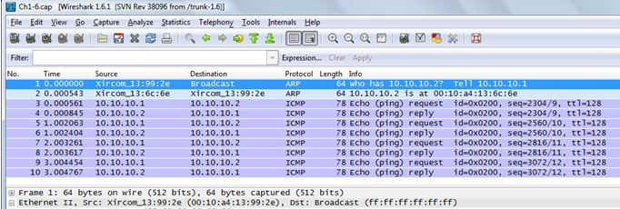
ARP Request
The source of the packet is 00-10-A4-13-99-2E (Computer 1). The destination address on the local area network shown is BROADCAST, which means that this message is being sent to all computers on the network. A query (Q) being asked is who has the IP address 10.10.10.2. Tell 10.10.10.1

Slide 9
Broadcast
The source of the packet is 00-10-A4-13-99-2E (Computer 1). The destination address on the local area network shown is BROADCAST, which means that this message is being sent to all computers on the network. A query (Q) being asked is who has the IP address 10.10.10.2. Tell 10.10.10.1

Slide 10
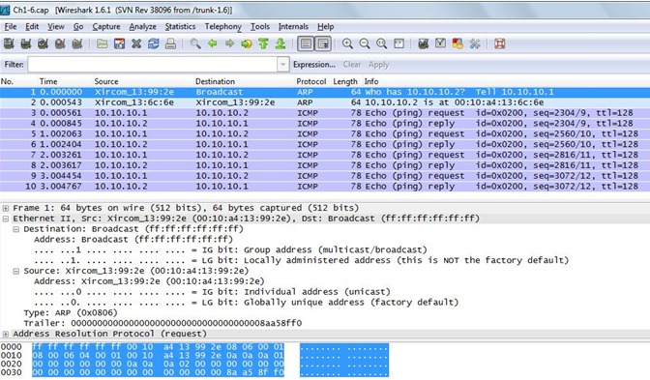
all “f” condition
The captured packets showing the ping from computer 1 to computer 2.
The destination address is BROADCAST as indicated by “ff ff ff ff ff ff” – the all “f“condition
Broadcast

Slide 11
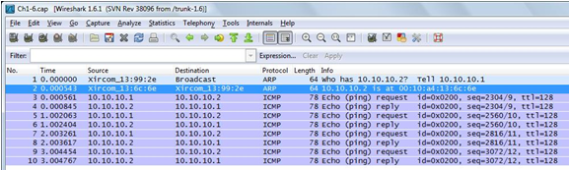
ARP Reply
The highlighted blue area shows computer 2 replying with its MAC address back to computer 1. This is called an ARP reply, which is a protocol where the MAC address is returned. The source of the ARP reply is from 00-10-A4-13-6C-6E (Computer 2) which is replying that the MAC address for 10.10.10.2 is 00-10-A4-13-6C-6E.
ARP Reply

Slide 12
ARP Reply
The highlighted blue area shows computer 2 replying with its MAC address back to computer 1. This is called an ARP reply, which is a protocol where the MAC address is returned. The source of the ARP reply is from 00-10-A4-13-6C-6E (Computer 2) which is replying that the MAC address for 10.10.10.2 is 00-10-A4-13-6C-6E.

Slide 13
ARP Reply
The highlighted blue area shows computer 2 replying with its MAC address back to computer 1. This is called an ARP reply, which is a protocol where the MAC address is returned. The source of the ARP reply is from 00-10-A4-13-6C-6E (Computer 2) which is replying that the MAC address for 10.10.10.2 is at 00-10-A4-13-6C-6E.
ARP Reply

Slide 14
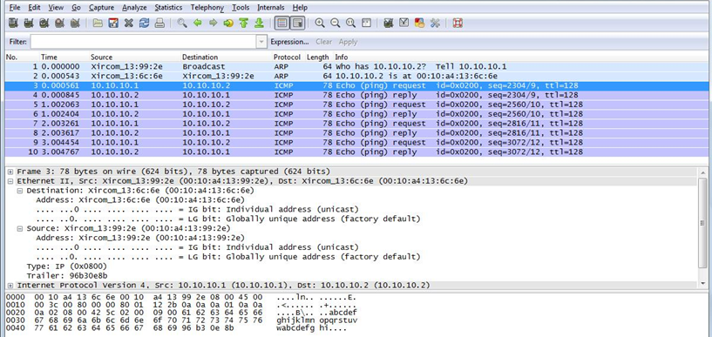
Echo Request
This image shows computer 1 sending an echo request directly to computer 2.
Echo Request

Slide 15
Echo Request
Notice in the echo request that the destination address is 00-10-A4-13-6C-6E (computer 2’s MAC address) and the source is 00-10-A4-13-99-2E (computer 1’s MAC address).
Echo Request

Slide 16
Echo Request
Recall that Computer 1 now knows the MAC address for IP address 10.10.10.2 so the ping request can be sent directly.
Echo Request

Slide 17
Capturing Data Packets
The first exercise with the Wireshark protocol analyzer demonstrated how to use the protocol analyzer to inspect captured packets.
In most cases, the user will want to capture data packets from their own network. The following demonstration describes how to use Wireshark to capture network data packets.

Slide 18
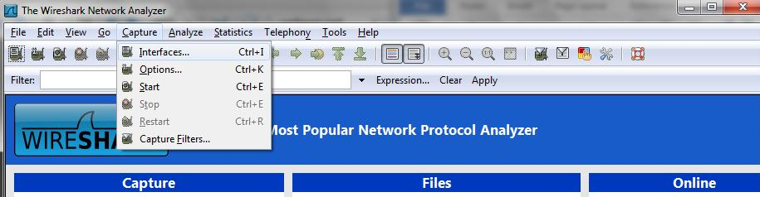
Capturing Data Packets
To capture packets on an operating network, you first need to select the interfaces in which you would like to obtain the capture.
You can do this by going to Capture > Interfaces.

Slide 19
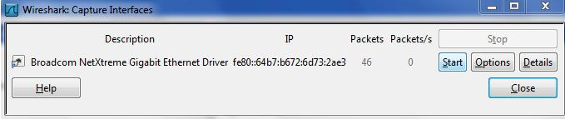
Capturing Data Packets
After selecting your interfaces, click Start to start capturing data packets. You can also get to the interface list by clicking on Interface List from the Wireshark home screen.

Slide 20
Capturing Data Packets
Step 2 To examine the packets, stop the simulation by clicking Capture > Stop. Remember, there must be some activity on your network for packets to be transferred.

Slide 21
Capturing Data Packets
You may see little traffic activity if your network is in the lab and there is limited network activity.
You can always use the ping command to generate some network data activity if needed.

Slide 22
Capturing Data Packets
To open a saved capture file, click File > Open or click Open from the Wireshark home screen.
To change capture options, click Capture > Options to change the options to your preferred settings.

